Slide 1
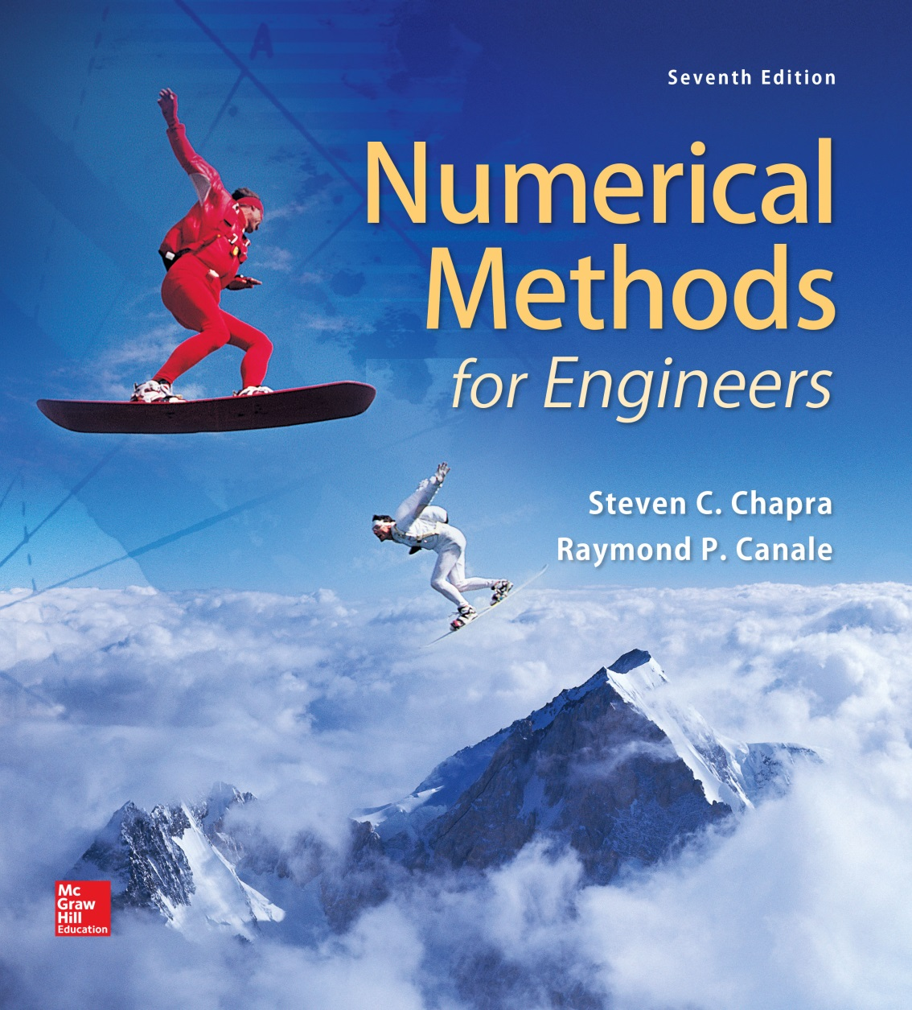
Chapter

Slide 2
Truncation Errors and the Taylor Series
Chapter 4
Non-elementary functions such as trigonometric, exponential, and others are expressed in an approximate fashion using Taylor series when their values, derivatives, and integrals are computed.
Any smooth function can be approximated as a polynomial. Taylor series provides a means to predict the value of a function at one point in terms of the function value and its derivatives at another point.

Slide 3
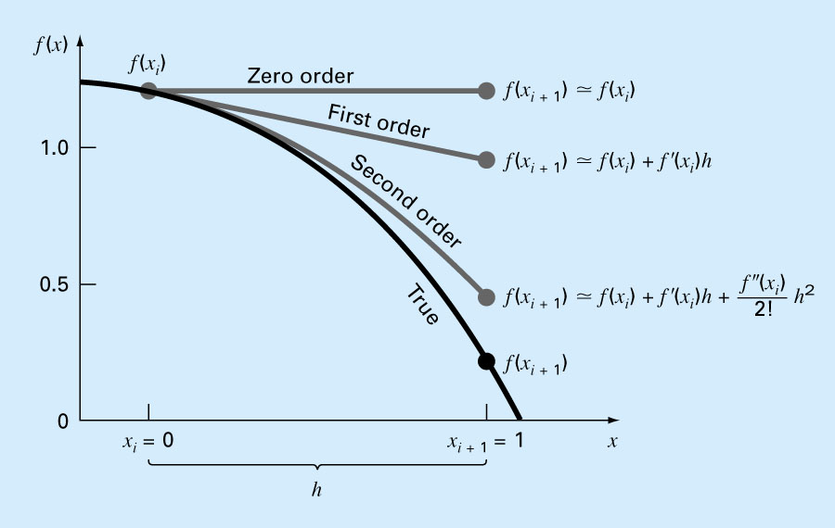
Figure 4.1

Slide 4
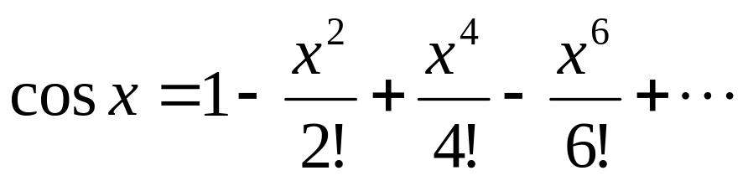
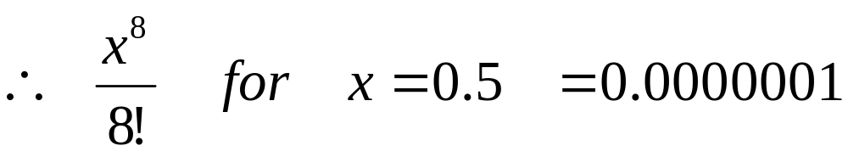
Example:
To get the cos(x) for small x:
If x=0.5
cos(0.5) =1-0.125+0.0026041-0.0000127+ … =0.877582
From the supporting theory, for this series, the error is no greater than the first omitted term.

Slide 5
Any smooth function can be approximated as a polynomial.
f(x_{i+1}) ≈ f(x_{i}) zero order approximation, only true if x_{i+1} and x_{i} are very close to each other.
f(x_{i+1}) ≈ f(x_{i}) + f′(x_{i}) (x_{i+1}-x_{i}) first order approximation, in form of a straight line

Slide 6
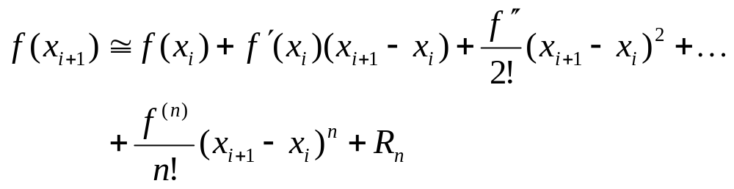
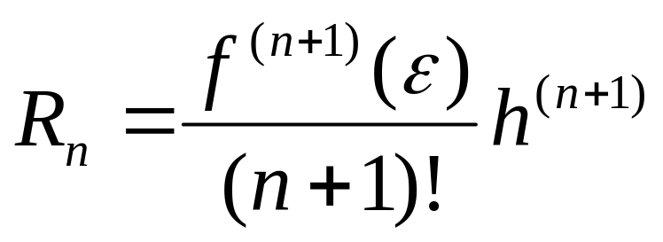
n^{th} order approximation
(x_{i+1}-x_{i})= h step size (define first)
Reminder term, R_{n}, accounts for all terms from (n+1) to infinity.

Slide 7
ε is not known exactly, lies somewhere between x_{i+1}>ε >x_{i .}
Need to determine f ^{n+1}(x), to do this you need f'(x).
If we knew f(x), there wouldn’t be any need to perform the Taylor series expansion.
However, R=O(h^{n+1}), (n+1)^{th} order, the order of truncation error is h^{n+1}.
O(h), halving the step size will halve the error.
O(h²), halving the step size will quarter the error.

Slide 8
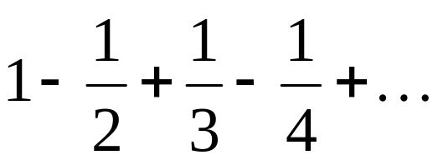
Truncation error is decreased by addition of terms to the Taylor series.
If h is sufficiently small, only a few terms may be required to obtain an approximation close enough to the actual value for practical purposes.
Example:
Calculate series, correct to the 3 digits.

Slide 9
Error Propagation
fl(x) refers to the floating point (or computer) representation of the real number x. Because a computer can hold a finite number of significant figures for a given number, there may be an error (round-off error) associated with the floating point representation. The error is determined by the precision of the computer (ε).

Slide 10
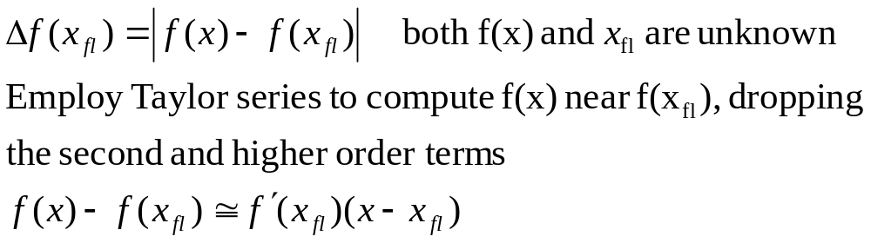
Suppose that we have a function f(x) that is dependent on a single independent variable x. fl(x) is an approximation of x and we would like to estimate the effect of discrepancy between x and fl(x) on the value of the function:

Slide 11
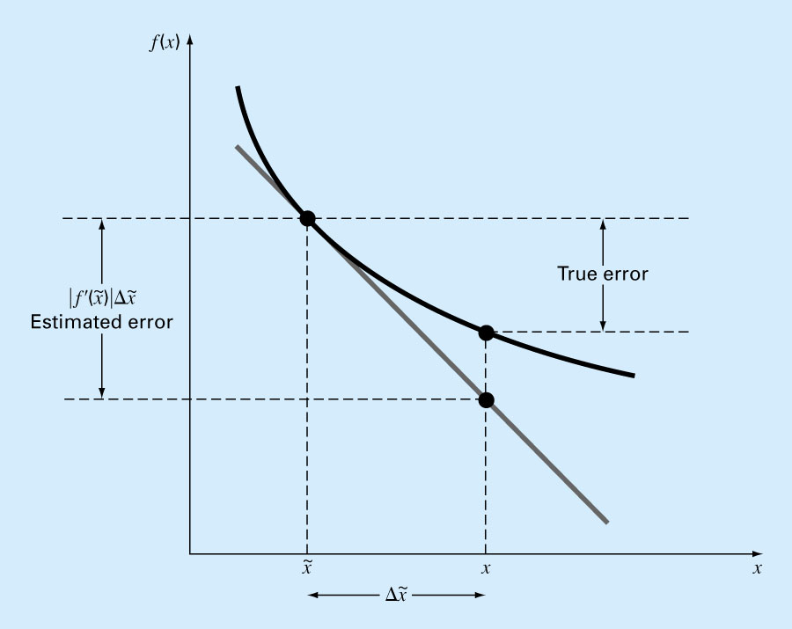
Figure 4.7

Slide 12
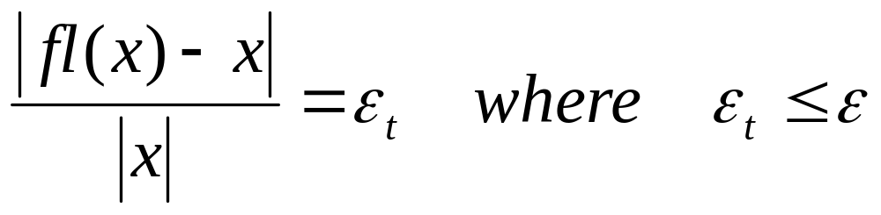
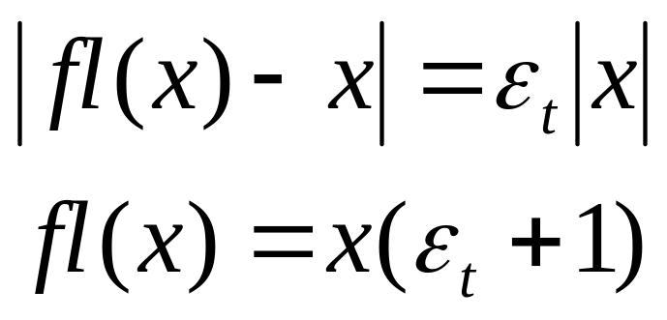
Also, let ε_{t}, the fractional relative error, be the error associated with fl(x). Then
Rearranging, we get
Machine epsilon, upper boundary

Slide 13
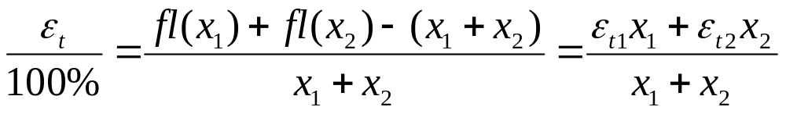
Case 1: Addition of x₁ and x₂ with associated errors ε_{t1} and ε_{t2} yields the following result:
fl(x₁)=x₁(1+ε_{t1})
fl(x₂)=x₂(1+ε_{t2})
fl(x₁)+fl(x₂)=ε_{t1} x₁+ε_{t2} x₂+x₁+x₂
A large error could result from addition if x₁ and x₂ are almost equal magnitude but opposite sign, therefore one should avoid subtracting nearly equal numbers.

Slide 14
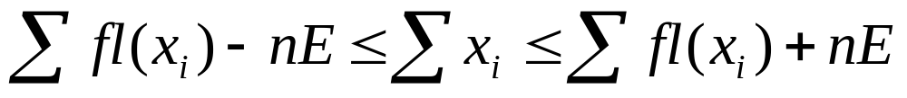
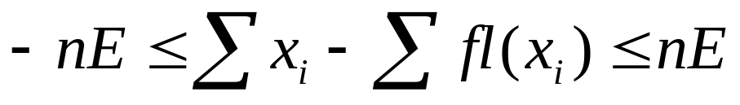
Generalization:
Suppose the numbers fl(x₁), fl(x₂), fl(x₃), …, fl(x_{n}) are approximations to x₁, x₂, x₃, … ,x_{n} and that in each case the maximum possible error is E.
fl(x_{i})-E ≤ x_{i} ≤ fl(x_{i})+E E_{ti} ≤E
It follows by addition that
So that
Therefore, the maximum possible error in the sum of fl(x_{i}) is .
nE
Notes:
x

Slide 15
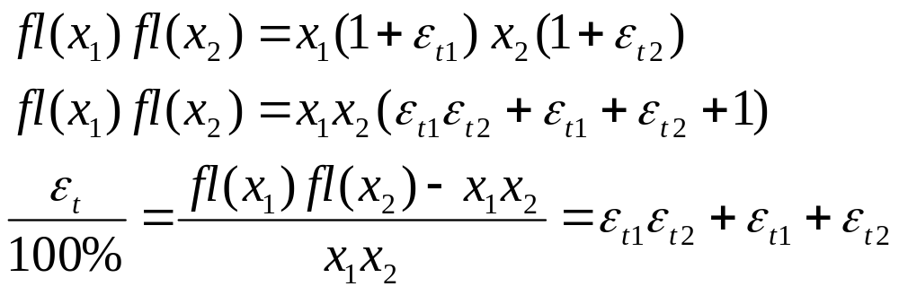
Case 2: Multiplication of x₁ and x₂ with associated errors e_{t1} and e_{t2} results in:

Slide 16
Since ε_{t1}, ε_{t2} are both small, the term ε_{t1}ε_{t2} should be small relative to ε_{t1}+ε_{t2}. Thus the magnitude of the error associated with one multiplication or division step should be ε_{t1}+ε_{t2}.
ε_{t1} ≤ε (upper bound)
Although error of one calculation may not be significant, if 100 calculations were done, the error is then approximately 100ε. The magnitude of error associated with a calculation is directly proportional to the number of multiplication steps.
Refer to Table 4.3

Slide 17
Overflow: Any number larger than the largest number that can be expressed on a computer will result in an overflow.
Underflow (Hole) : Any positive number smaller than the smallest number that can be represented on a computer will result an underflow.
Stable Algorithm: In extended calculations, it is likely that many round-offs will be made. Each of these plays the role of an input error for the remainder of the computation, impacting the eventual output. Algorithms for which the cumulative effect of all such errors are limited, so that a useful result is generated, are called “stable” algorithms. When accumulation is devastating and the solution is overwhelmed by the error, such algorithms are called unstable.

Slide 18
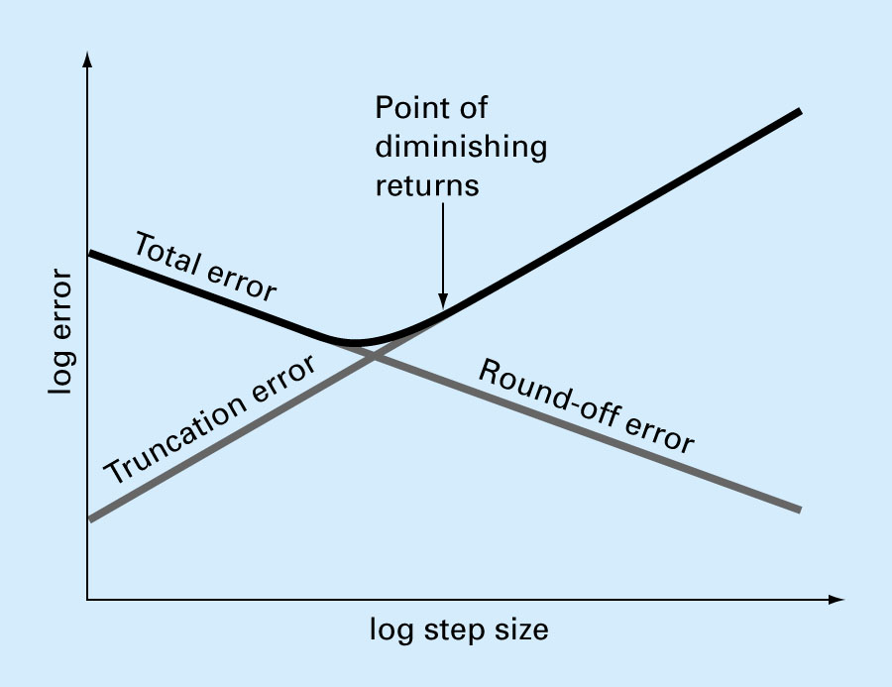
Figure 4.8

